Slide 1

Micro Credit Defaulter Model

Slide 2
Use Case
There are multiple telecommunication company that are providing micro loan credit to their customers which help the low financial population not to disconnect from the communication world. So, in this use case there are multiple customers which taken loan, and some don’t, so I must predict by taking important features that whether in future customers having this type of inputs and history will be able to pay back the loan or not. So, this a real-world use case which will help telecom industry to provide the loan to which type of customers.

Slide 3
Approach and Life Cycle

Slide 4
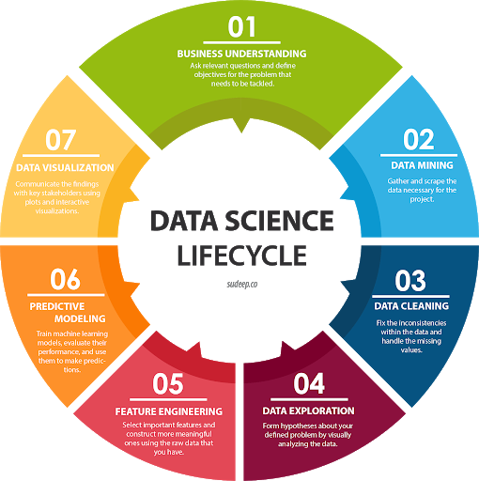

Slide 5
Review of Literature
Micro Credit Loan policy is offered by MFI which is very useful for the low-income population, In this current era everyone need to connect virtually so this policy provide the option to low-income people to take a next step in this, In India also Jio and BSNL are providing this type of facility to their low-income customers which need loan if they don’t have enough and can payback the amount. So, I also go through some telecom sites and see that most of the remote people and low income population taking the benefit for this, and for sure in the future these telecom industry will be able to provide loan on their smart package i.e. 3 month package (include data and call) so this will help both customers and most important the industry, but before bringing this policy company should able to find a way that if they provide the loan on smart packages then how they will get the payback because 3 months is big time, customers may be change the network.

Slide 6

Data Cleaning
This step include data cleaning, In this dataset there are negative values for some features like “age of network” and “amount” etc. So, removed them and replace with 0.
Most of the features are continuous and numeric so using QQ plot I check whether the data are normally distributed or not.
Outliers may have the high impact in distracting the model performance, So I used IQR and third deviation range value to replace all the outliers.
The payback amount is 6 and 12 only but some of the rows have value 0 so I remove that error data.

Slide 7

Exploratory Data Analysis

Slide 8
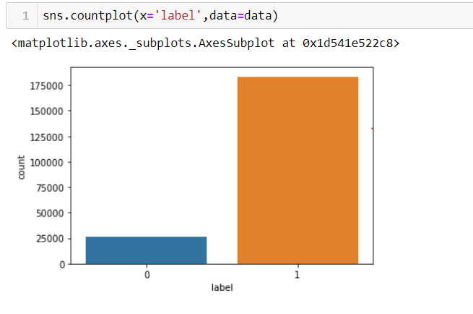
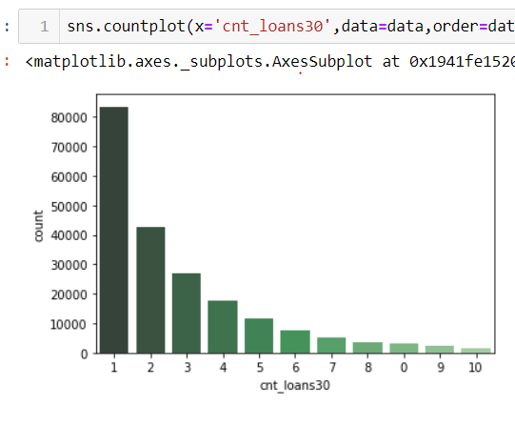
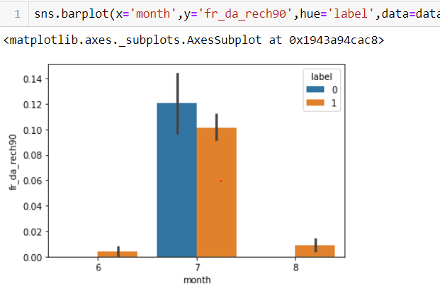

Slide 9

Feature Engineering
This step include the feature selection and feature scaling.
There are 30+ features and most of them are continuous. So, by plotting correlation heatmap it shows most then 9 features are highly correlated.
So I removed those features because this will cause problem of overfitting.
Also, Feature Scaling is important factor, as there are multiple features which had their magnitude and unit. So, to scale down at one scale I used Standardization.

Slide 10
Creating Model
This is a classification problem where dependent features is label which means if 1 – Non-Defaulter, 0 – Defaulter.
So, I used multiple model and tried hyperparameter tuning with cross validation. Models are Logistic regression, KNN, Random Forest, SVC, Gradient Boosting, ExtraTreeClassifier.
As the data set is imbalance so to make that balance, I used one library called SMOTE Tomek, which will increase data pint of less label value.

Slide 11
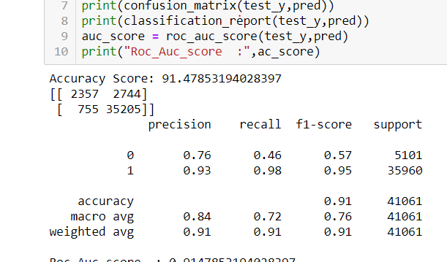
Metrics : Accuracy, Confusion Matrix
Random forest is providing the best result in term of accuracy and less false positive value.
As Random forest is robust to imbalance data set because of multiple week learners and internally uses decision tree and robust to outliers.

Slide 12
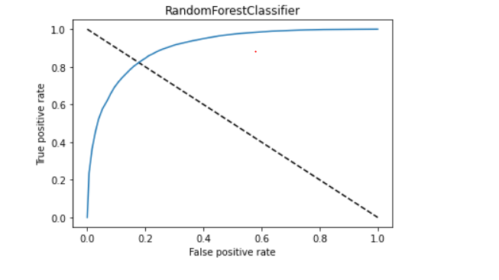
Roc Curve
As the Roc value is near to 0.85 so it is classified the 0 and 1 efficiently and our model is performing well in this case, and area under curve is justify the prediction.

Slide 13
Key Findings and Conclusions of the Study
There are various aspect of the dataset and observation from my point of view:
From the statistical analysis it is clearly see that there is difference between the 75th percentile and max so this is an indication of the outliers in the dataset.
There is no defaulter in 8th month i.e. August month of 2016 year
In June month there are more defaulter as compared to non-defaulter and their age on cellular network is also more.
Removing unwanted column like msisdn number which does not play any imp role because that is unique.
Removing telecom circle and date column, which is also not an imp features, because telecom circle is same for all.
In this data set there are negative values which are from the total amount, age which can’t be negative.

